Slide 1
Amended and Prior Year Returns
4491-34 Amended and Prior Year Returns v11.0 VO.pptx
Form 1040X
Pub 4012 Tab 12

Slide 2
AMENDED RETURN
Follow process outlined
Print any schedules that changed
If a change to taxable Social Security, print out new 1040, page 1; clearly mark “AS AMENDED” across the front.
Do NOT print the revised 1040 otherwise.
Include any new or revised documents (added W2, etc)
Can only prepared by counselors who were trained in the relevant year

Slide 3
OVERVIEW
Amend a return to:
Correct error on original return
Add new information
Recognize the time limit for refunds on amended returns
Understand process for amending returns in TaxWise and submitting

Slide 4
COMMON REASONS TO AMEND
Change in status or dependency
Change in income or withholding
Change in deductions, adjustments or credits

Slide 5
AMENDING FEDERAL RETURNS IN TAXWISE
Open the original return that is to be amended
Add 1040X and NJ 1040X from Forms List
Before making any changes
Check the red highlighted box near the top of page 1 of Form 1040X
Check the corresponding box on page 1 of the state amended return form.
Amend federal and state returns simultaneously
Make changes as if preparing the original return

Slide 6
Make Corrections On Original Return – Not On 1040X
If a corrected 1099-DIV was received, simply change the entries to match the new form
If a new 1099-INT was received, enter the information on the next available Interest Worksheet line
If a new W-2 or 1099-R was received, bring up new form and input data

Slide 7
AMENDED RETURNS
Explain changes on line C of page 1 of Form 1040X and on the state form, referencing line numbers of changes
Dependents not included on original return must also be entered on line 31 of page 2 of Form 1040X

Slide 8
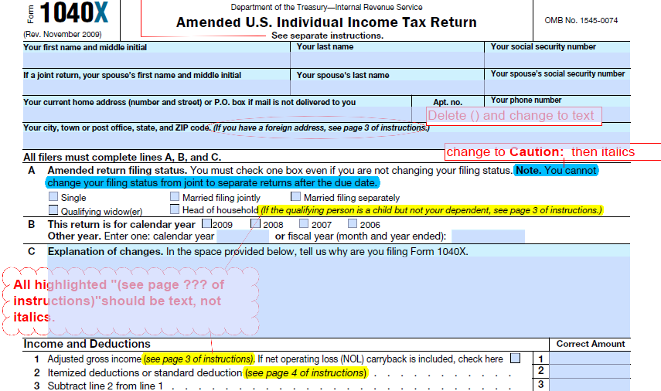

Slide 9
1040X LINE 31 DEPENDENTS

Slide 10
FINISHING THE AMENDED RETURN
2 copies of the amended returns
Include all forms added or changed and copies of all supporting documents

Slide 11
FINISHING THE AMENDED RETURNS
After quality review, review amended returns with taxpayer
The taxpayer will sign and mail the amended returns
1040-X must be mailed to the same IRS Service Center as the original return.
Taxpayer must include same extra papers as federal return with any state amendment

Slide 12
Prior Year Returns
Can use TaxWise to prepare prior year returns, but…
Ability to e-file is not known at this time.
TaxWise Online allows access to prior year automatically, TaxWise Desktop requires installation on computer
To be prepared ONLY by volunteers with certification for relevant year(s)
Should also have references (e.g. Pub 17) for relevant year(s)

Slide 13
AMENDED RETURNS
QUESTIONS?
COMMENTS?

